Slide 1
Transforming Our World:
2030 Agenda for Sustainable Development
Department of Public Information
United Nations

Slide 2
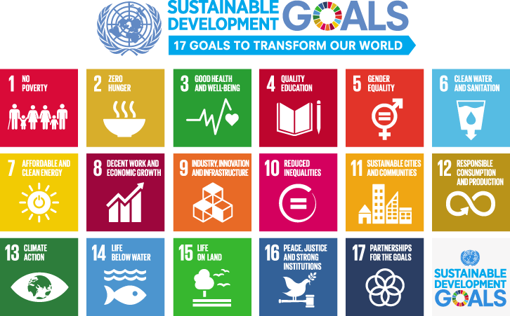
Notes:
On 1 January, 2016, the 17 Sustainable Development Goals (SDGs) of the 2030 Agenda for Sustainable Development—adopted by world leaders in September 2015 at an historic UN Summit — officially came into force. Over the next fifteen years, with these new Goals that universally apply to all, countries will mobilize efforts to end all forms of poverty, fight inequalities and tackle climate change, while ensuring that no one is left behind.
The SDGs build on the success of the Millennium Development Goals (MDGs) and aim to go further to end all forms of poverty. The new Goals are unique in that they call for action by all countries, poor, rich and middle-income to promote prosperity while protecting the planet. They recognize that ending poverty must go hand-in-hand with strategies that build economic growth and addresses a range of social needs including education, health, social protection, and job opportunities, while tackling climate change and environmental protection.

Slide 3
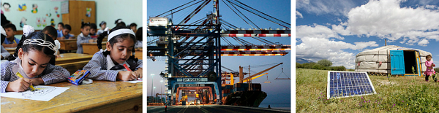
Three Dimensions of Sustainable Development
Sustainable development has been defined as development that meets the needs of the present without compromising the ability of future generations to meet their own needs.
For sustainable development to be achieved, it is crucial to harmonize three core elements: economic growth, social inclusion and environmental protection.
Notes:
Sustainable development has been defined as development that meets the needs of the present without compromising the ability of future generations to meet their own needs.
Sustainable development calls for concerted efforts towards building an inclusive, sustainable and resilient future for people and planet.
For sustainable development to be achieved, it is crucial to harmonize three core elements: economic growth, social inclusion and environmental protection. These elements are interconnected and all are crucial for the well-being of individuals and societies.
Eradicating poverty in all its forms and dimensions is an indispensable requirement for sustainable development. To this end, there must be promotion of sustainable, inclusive and equitable economic growth, creating greater opportunities for all, reducing inequalities, raising basic living standards, fostering equitable social development and inclusion, and promoting integrated and sustainable management of natural resources and ecosystems.

Slide 4
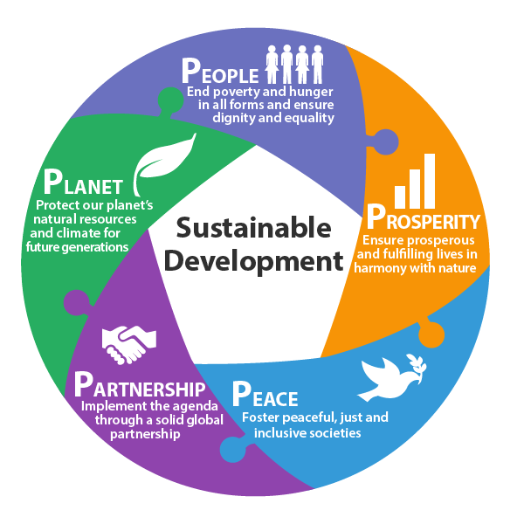
Another Way to Look at SDGs – The Five Ps
Notes:
What are the elements underpinning the Sustainable Development Goals?
The Goals and targets will stimulate action over the next 15 years in areas of critical importance: people, planet, prosperity, peace and partnership.
People - to end poverty and hunger, in all their forms and dimensions, and to ensure that all human beings can fulfil their potential in dignity and equality and in a healthy environment. (Goal 1, 2, 3, 4, 5 and 6)
Prosperity - to ensure that all human beings can enjoy prosperous and fulfilling lives and that economic, social and technological progress occurs in harmony with nature. (Goal 7, 8, 9, 10 and 11)
Planet - to protect the planet from degradation, including through sustainable consumption and production, sustainably managing its natural resources and taking urgent action on climate change, so that it can support the needs of the present and future generations. (Goal 12, 13, 14 and 15)
Peace - to foster peaceful, just and inclusive societies free from fear and violence. There can be no sustainable development without peace and no peace without sustainable development. (Goal 16)
Partnership - to mobilize the means required to implement this agenda through a revitalised global partnership for sustainable development, based on a spirit of strengthened global solidarity, focused in particular on the needs of the poorest and most vulnerable and with the participation of all countries, all stakeholders and all people. (Goal 17)

Slide 5
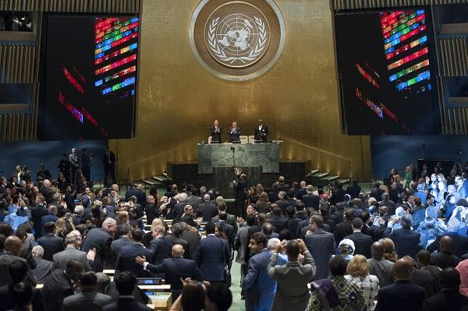
Sustainable Development Summit 2015
Notes:
In September 2015, more than 150 world leaders attended the UN Sustainable Development Summit held at UN Headquarters in New York to formally adopt an ambitious new sustainable development agenda.
Reflected in this Agenda are seventeen Sustainable Development Goals - our shared vision of humanity and a social contract between the world's leaders and the people.

Slide 6
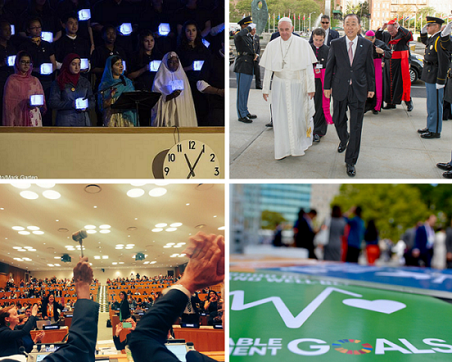
Sustainable Development Summit 2015
Notes:
While the SDGs are not legally binding, governments are expected to take ownership and establish national frameworks for the achievement of the 17 Goals. Countries have the primary responsibility for follow-up and review of the progress made in implementing the Goals, which will require quality, accessible and timely data collection. Regional follow-up and review will be based on national-level analyses and contribute to follow-up and review at the global level.

Slide 7
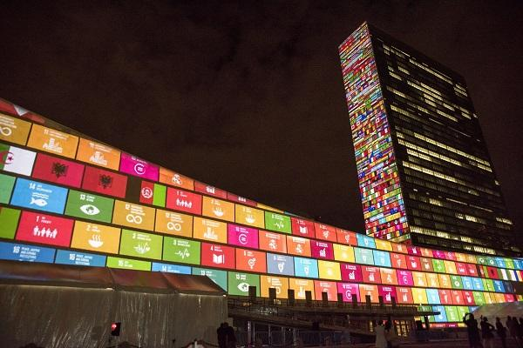
SDGs: Universal
Notes:
The Sustainable Development Goals are universal and call for action by all countries and all people.
Taking action to achieve the sustainable development agenda will ensure a life of dignity for all and build greater shared prosperity. It is in everybody’s interest.
2016 presents an unprecedented opportunity to bring the countries and citizens of the world together to embark on a new path to improve the lives of people everywhere.
The Agenda looks at both rich and poor countries and inequalities between and within countries.
The goals take into account different national realities, capacities and levels of development.

Slide 8
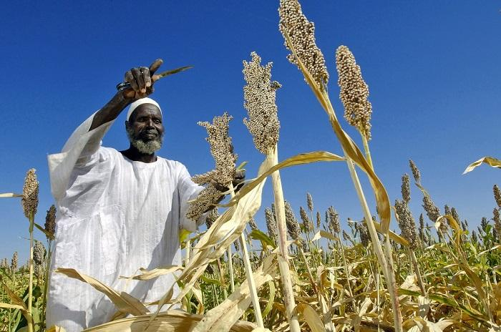
SDGs: Indivisible
Notes:
Sustainable development calls for concerted efforts towards building an inclusive, sustainable and resilient future for people and planet.
The 2030 Agenda for Sustainable Development will spur actions by governments, the private sector, civil society and other stakeholders to end poverty and build a more sustainable world over the next 15 years for all people.
The Sustainable Development Goals and targets are global in nature and universally applicable, taking into account different national realities, capacities and levels of development and respecting national policies and priorities.
These goals are not independent from each other—they need to be implemented in an integrated manner.
There are interlinkages between all the goals. You can’t have zero hunger without tackling climate change or ensuring there is peace.
You can’t have gender equality if education is not provided to all.

Slide 9
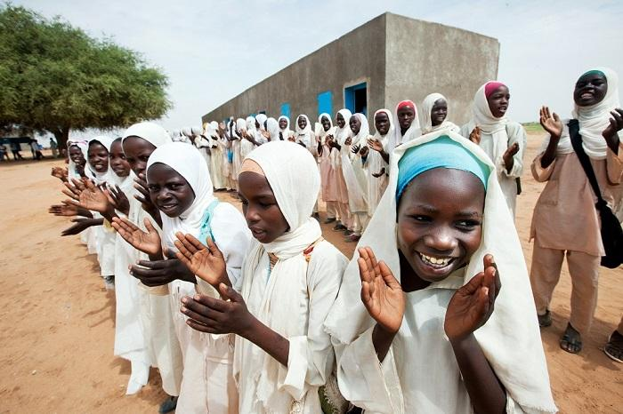
SDGs: Transformative
Notes:
This is the people’s agenda, a plan of action for ending poverty in all its dimensions, irreversibly, everywhere.
The Agenda with its 17 Goals is broad and ambitious and emphasizes that no one should be left behind.
The Goals recognise that ending poverty must go hand in hand with strategies that build economic growth and addresses a range of social needs including education, health and job opportunities, while tackling climate change and environmental protection.

Slide 10
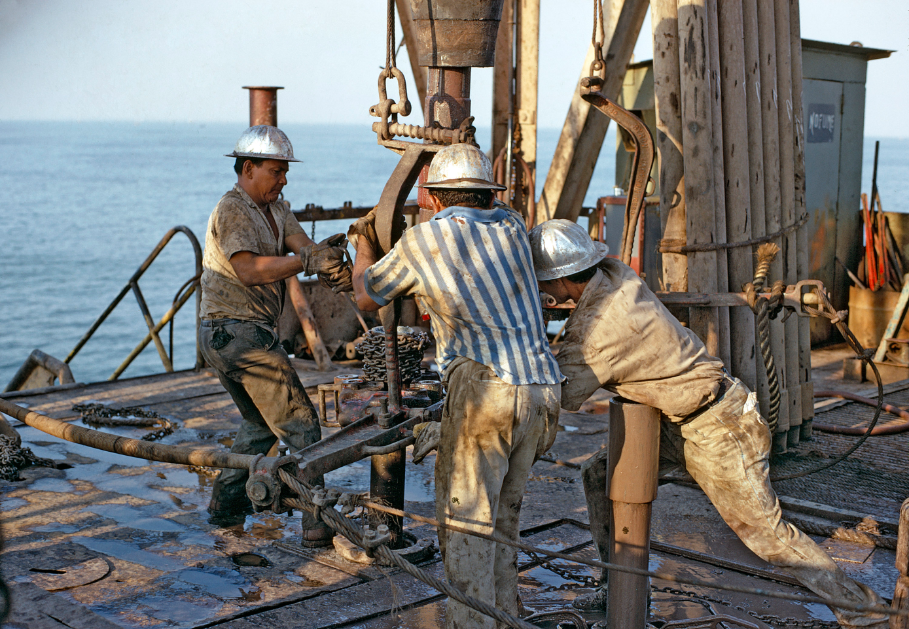
So now it is about implementation
Notes:
The 17 Goals and 169 targets will be monitored using a global indicator framework. As the final piece of the architecture for implementing the 2030 Agenda for Sustainable Development, the proposed global indicator framework for the Sustainable Development Goals (SDGs) was agreed by the 47th Session of the United Nations Statistical Commission (March 2016).
Governments are expected to take ownership and establish national frameworks for the achievement of the 17 Goals. Countries have the primary responsibility for follow-up and review of the progress made in implementing the Goals, which will require quality, accessible and timely data collection.
Regional follow-up and review will be based on national-level analyses and contribute to follow-up and review at the global level.
An annual Forum – the High Level Political Forum on Sustainable Development will oversee national and thematic reviews of the implementation of the 2030 Agenda
An annual SDG Progress Report is also expected

Slide 11
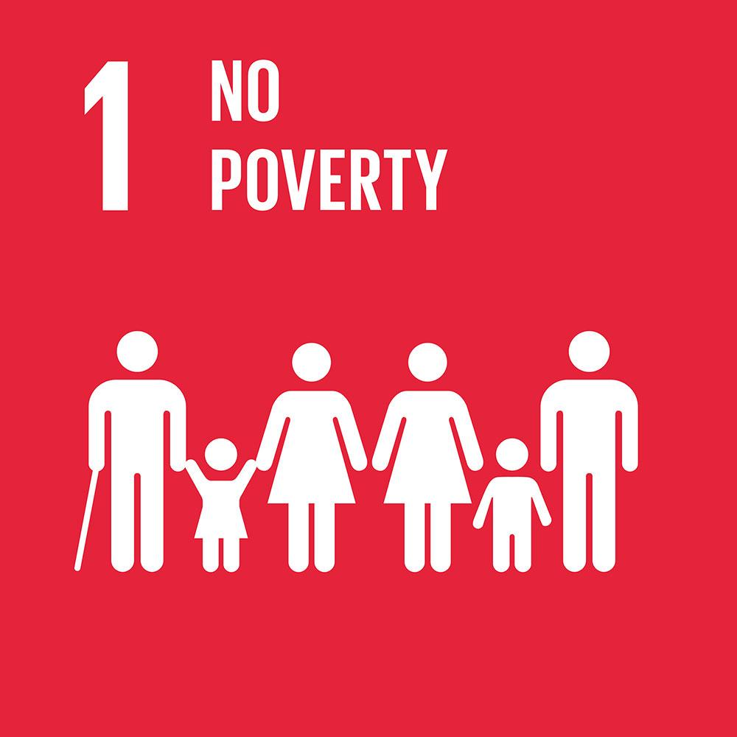
Goal 1: End poverty in all its forms everywhere
Notes:
Extreme poverty rates have been cut by more than half since 1990. While this is a remarkable achievement, one in five people in developing regions still live on less than $1.25 a day, and there are millions more who make little more than this daily amount, plus many people risk slipping back into poverty.
Poverty is more than the lack of income and resources to ensure a sustainable livelihood. Its manifestations include hunger and malnutrition, limited access to education and other basic services, social discrimination and exclusion as well as the lack of participation in decision-making. Economic growth must be inclusive to provide sustainable jobs and promote equality.

Slide 12
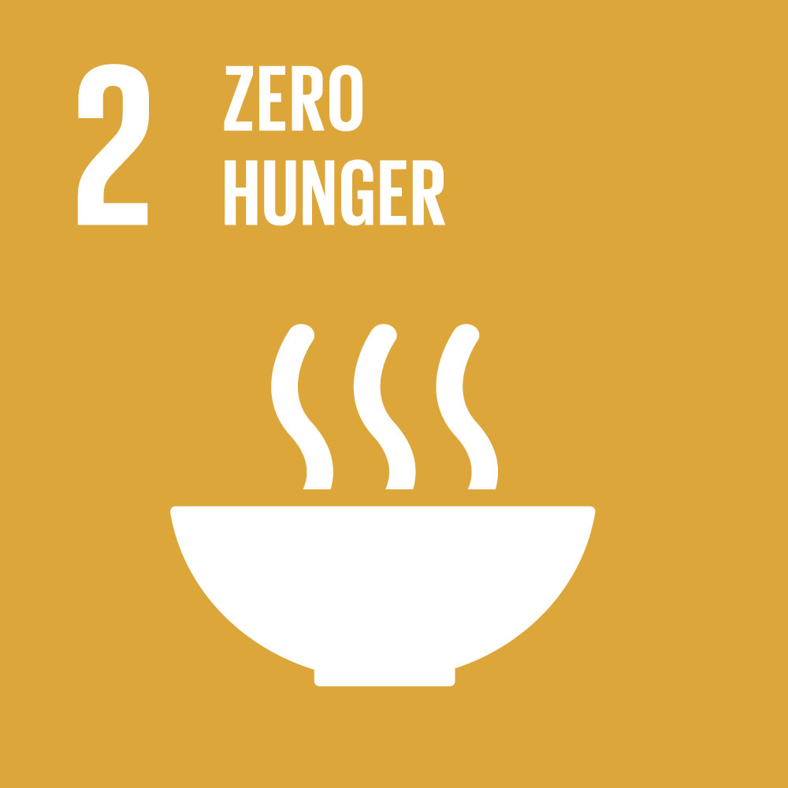
Goal 2: End hunger, achieve food security and improved nutrition and promote sustainable agriculture
Notes:
If done right, agriculture, forestry and fisheries can provide nutritious food for all and generate decent incomes, while supporting people-centred rural development and protecting the environment.
Right now, our soils, freshwater, oceans, forests and biodiversity are being rapidly degraded. Climate change is putting even more pressure on the resources we depend on, increasing risks associated with disasters such as droughts and floods. Many rural women and men can no longer make ends meet on their land, forcing them to migrate to cities in search of opportunities.
A profound change of the global food and agriculture system is needed if we are to nourish today’s 795 million hungry and the additional 2 billion people expected by 2050.
The food and agriculture sector offers key solutions for development, and is central for hunger and poverty eradication

Slide 13

Goal 3: Ensure healthy lives and promote well-being for all at all ages
Notes:
Ensuring healthy lives and promoting the well-being for all at all ages is essential to sustainable development. Significant strides have been made in increasing life expectancy and reducing some of the common killers associated with child and maternal mortality. Major progress has been made on increasing access to clean water and sanitation, reducing malaria, tuberculosis, polio and the spread of HIV/AIDS. However, many more efforts are needed to fully eradicate a wide range of diseases and address many different persistent and emerging health issues.

Slide 14

Goal 4: Ensure inclusive and quality education for all and promote lifelong learning
Notes:
Obtaining a quality education is the foundation to improving people’s lives and sustainable development. Major progress has been made towards increasing access to education at all levels and increasing enrolment rates in schools particularly for women and girls. Basic literacy skills have improved tremendously, yet bolder efforts are needed to make even greater strides for achieving universal education goals. For example, the world has achieved equality in primary education between girls and boys, but few countries have achieved that target at all levels of education.

Slide 15

Goal 5: Achieve gender equality and empower all women and girls
Notes:
While the world has achieved progress towards gender equality and women’s empowerment under the Millennium Development Goals (including equal access to primary education between girls and boys), women and girls continue to suffer discrimination and violence in every part of the world.
Gender equality is not only a fundamental human right, but a necessary foundation for a peaceful, prosperous and sustainable world.
Providing women and girls with equal access to education, health care, decent work, and representation in political and economic decision-making processes will fuel sustainable economies and benefit societies and humanity at large.

Slide 16
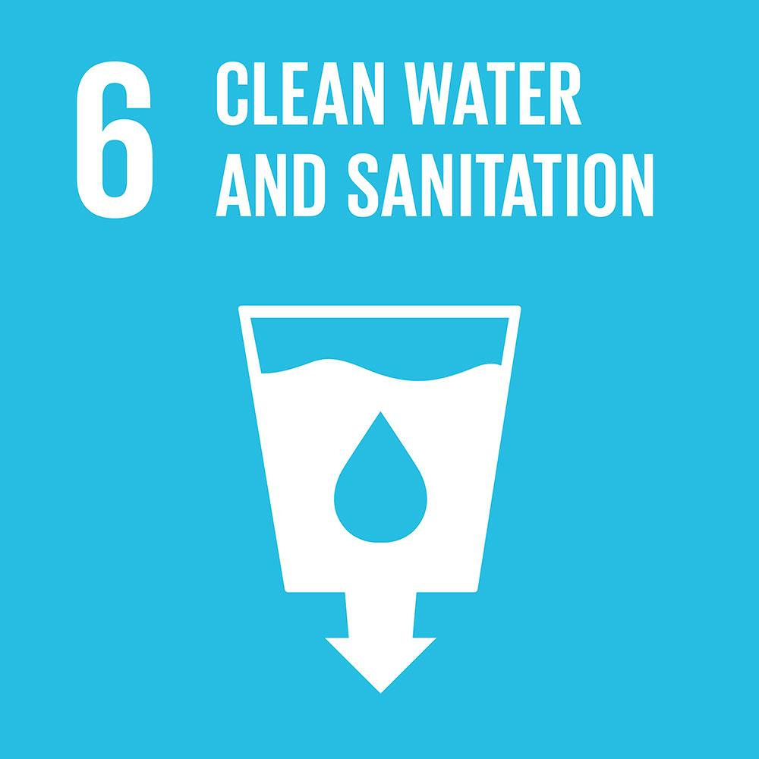
Goal 6: Ensure access to water and sanitation for all
Notes:
Clean, accessible water for all is an essential part of the world we want to live in. There is sufficient fresh water on the planet to achieve this. But due to bad economics or poor infrastructure, every year millions of people, most of them children, die from diseases associated with inadequate water supply, sanitation and hygiene.
Water scarcity, poor water quality and inadequate sanitation negatively impact food security, livelihood choices and educational opportunities for poor families across the world. Drought afflicts some of the world’s poorest countries, worsening hunger and malnutrition.
By 2050, at least one in four people is likely to live in a country affected by chronic or recurring shortages of fresh water

Slide 17
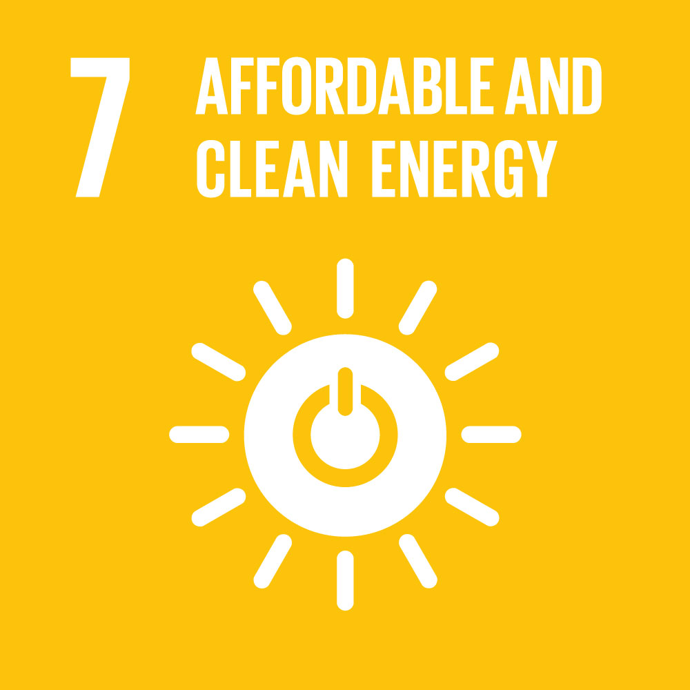
Goal 7: Ensure access to affordable, reliable, sustainable and modern energy for all
Notes:
Energy is central to nearly every major challenge and opportunity the world faces today. Be it for jobs, security, climate change, food production or increasing incomes, access to energy for all is essential.
Sustainable energy is opportunity – it transforms lives, economies and the planet.
UN Secretary-General Ban Ki-moon is leading a Sustainable Energy for All initiative to ensure universal access to modern energy services, improve efficiency and increase use of renewable sources.

Slide 18
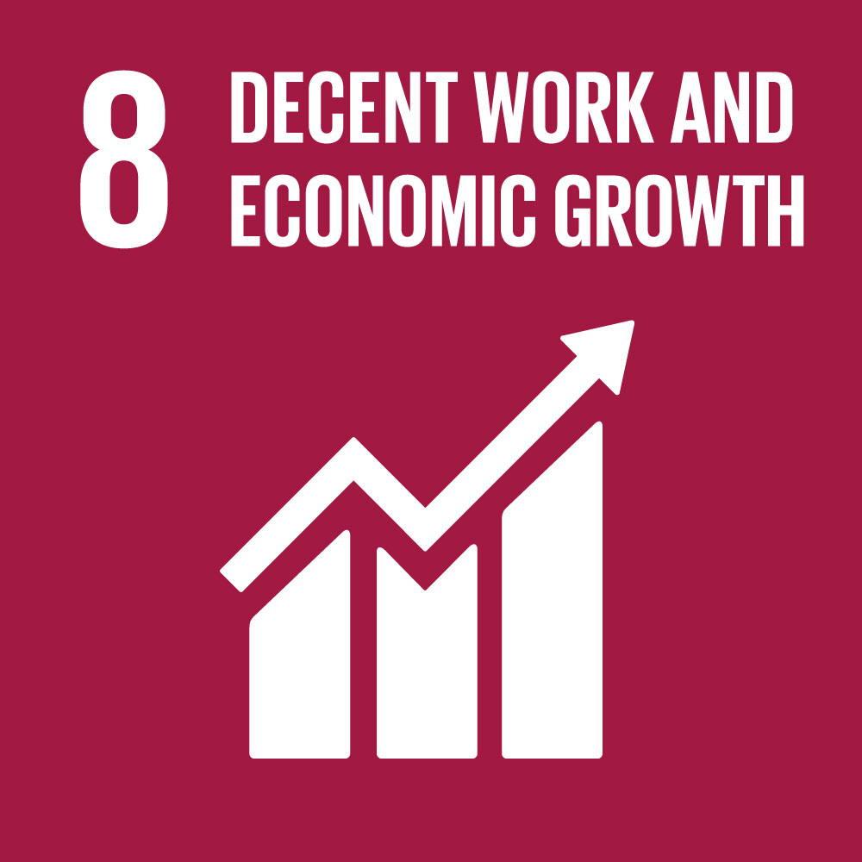
Goal 8: Promote inclusive and sustainable economic growth, employment and decent work for all
Notes:
Roughly half the world’s population still lives on the equivalent of about US$2 a day. And in too many places, having a job doesn’t guarantee the ability to escape from poverty. This slow and uneven progress requires us to rethink and retool our economic and social policies aimed at eradicating poverty.
A continued lack of decent work opportunities, insufficient investments and under-consumption lead to an erosion of the basic social contract underlying democratic societies: that all must share in progress. . The creation of quality jobs will remain a major challenge for almost all economies well beyond 2015.
Sustainable economic growth will require societies to create the conditions that allow people to have quality jobs that stimulate the economy while not harming the environment. Job opportunities and decent working conditions are also required for the whole working age population.

Slide 19
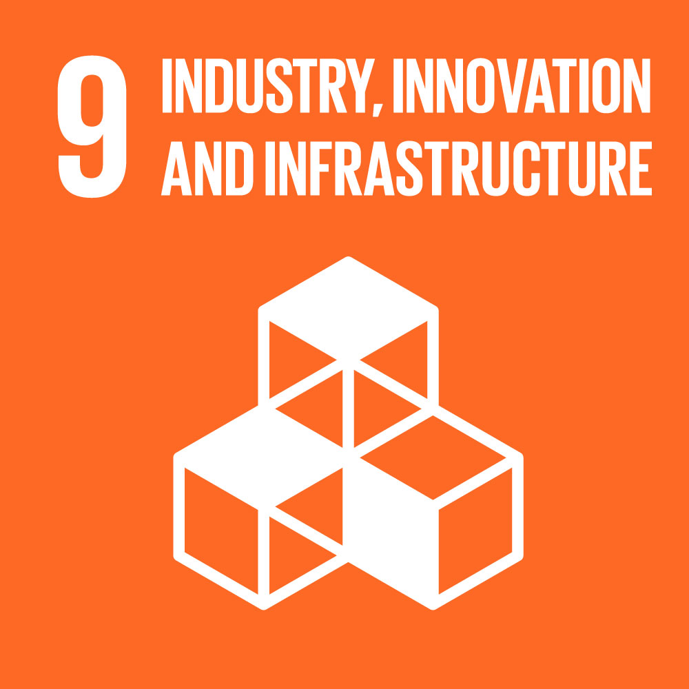
Goal 9: Build resilient infrastructure, promote sustainable industrialization and foster innovation
Notes:
Investments in infrastructure – transport, irrigation, energy and information and communication technology – are crucial to achieving sustainable development and empowering communities in many countries. It has long been recognized that growth in productivity and incomes, and improvements in health and education outcomes require investment in infrastructure.
Inclusive and sustainable industrial development is the primary source of income generation, allows for rapid and sustained increases in living standards for all people, and provides the technological solutions to environmentally sound industrialization.
Technological progress is the foundation of efforts to achieve environmental objectives, such as increased resource and energy-efficiency. Without technology and innovation, industrialization will not happen, and without industrialization, development will not happen.

Slide 20
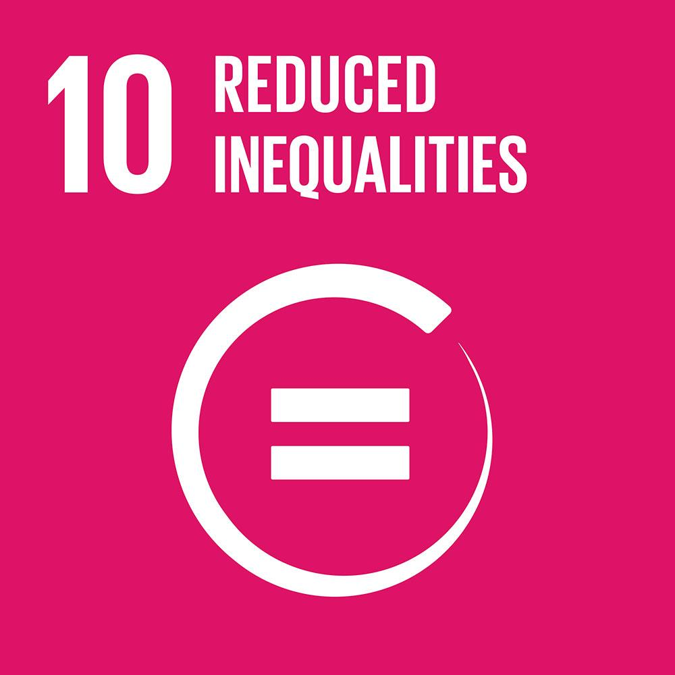
Goal 10: Reduce inequality within and among countries
Notes:
The international community has made significant strides towards lifting people out of poverty. The most vulnerable nations – the least developed countries, the landlocked developing countries and the small island developing states – continue to make inroads into poverty reduction. However, inequality still persists and large disparities remain in access to health and education services and other assets.
Additionally, while income inequality between countries may have been reduced, inequality within countries has risen. There is growing consensus that economic growth is not sufﬁcient to reduce poverty if it is not inclusive and if it does not involve the three dimensions of sustainable development – economic, social and environmental.
To reduce inequality, policies should be universal in principle paying attention to the needs of disadvantaged and marginalized populations.

Slide 21
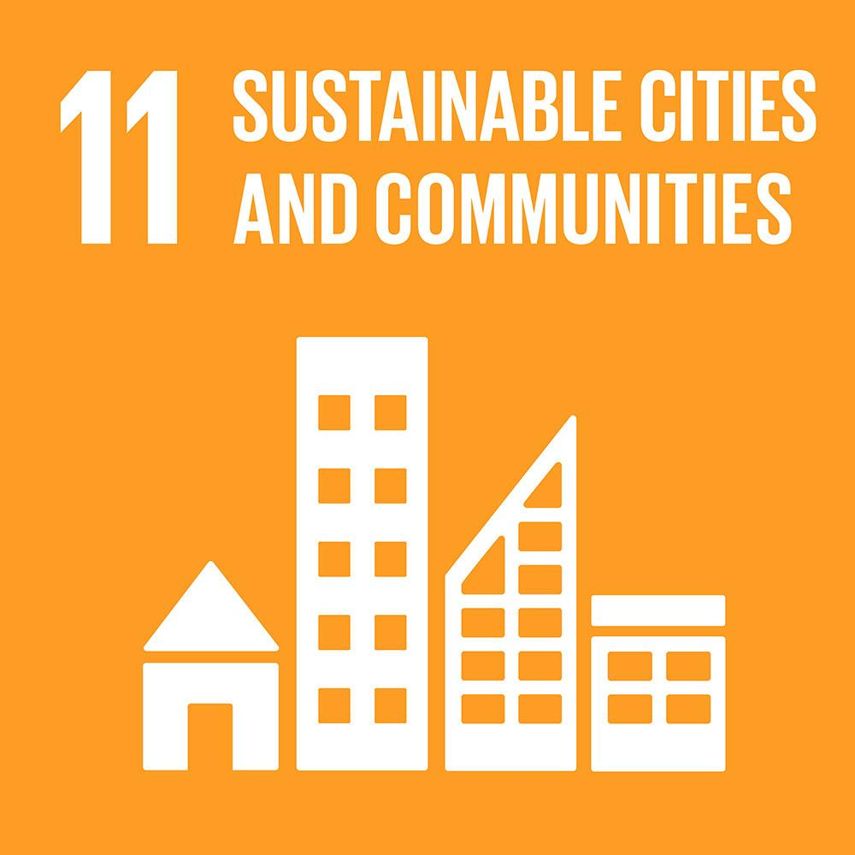
Goal 11: Make cities inclusive, safe, resilient and sustainable
Notes:
Cities are hubs for ideas, commerce, culture, science, productivity, social development and much more. At their best, cities have enabled people to advance socially and economically.
However, many challenges exist to maintaining cities in a way that continues to create jobs and prosperity while not straining land and resources. Common urban challenges include congestion, lack of funds to provide basic services, a shortage of adequate housing and declining infrastructure.
The challenges cities face can be overcome in ways that allow them to continue to thrive and grow, while improving resource use and reducing pollution and poverty. The future we want includes cities of opportunities for all, with access to basic services, energy, housing, transportation and more.

Slide 22
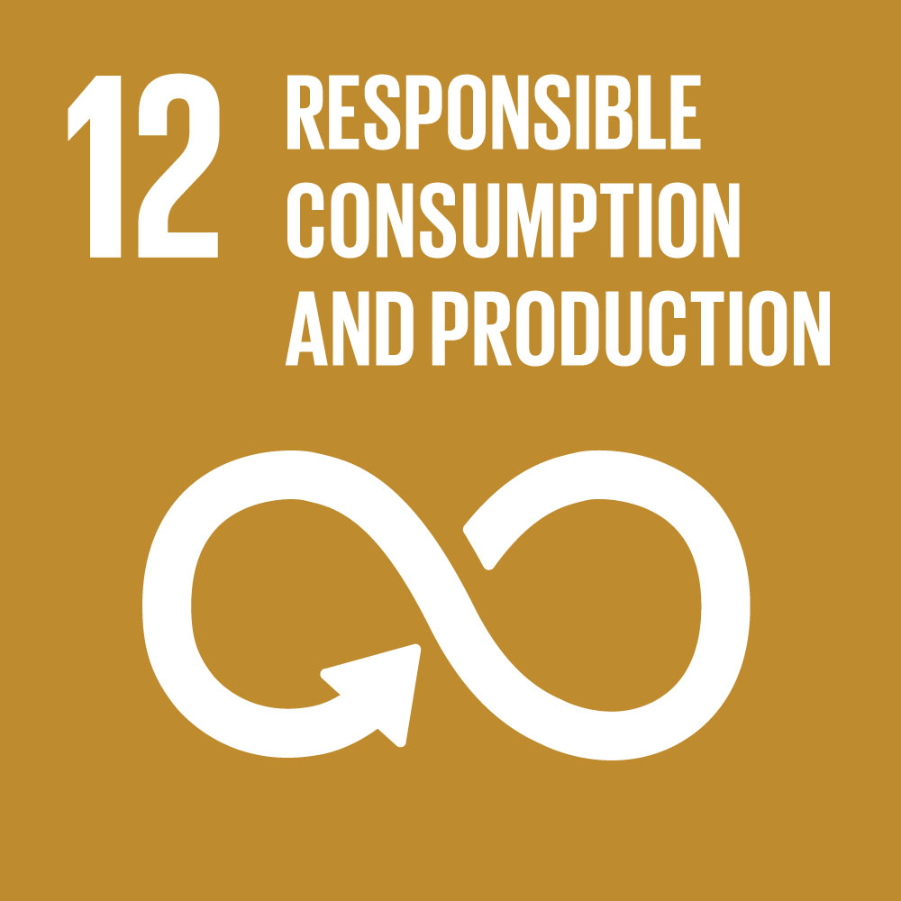
Goal 12: Ensure sustainable consumption and production patterns
Notes:
Sustainable consumption and production is about promoting resource and energy efficiency, sustainable infrastructure, and providing access to basic services, green and decent jobs and a better quality of life for all. Its implementation helps to achieve overall development plans, reduce future economic, environmental and social costs, strengthen economic competitiveness and reduce poverty.
Sustainable consumption and production aims at “doing more and better with less,” increasing net welfare gains from economic activities by reducing resource use, degradation and pollution along the whole lifecycle, while increasing quality of life. It involves different stakeholders, including business, consumers, policy makers, researchers, scientists, retailers, media, and development cooperation agencies, among others.
It also requires a systemic approach and cooperation among actors operating in the supply chain, from producer to final consumer. It involves engaging consumers through awareness-raising and education on sustainable consumption and lifestyles, providing consumers with adequate information through standards and labels and engaging in sustainable public procurement, among others.

Slide 23
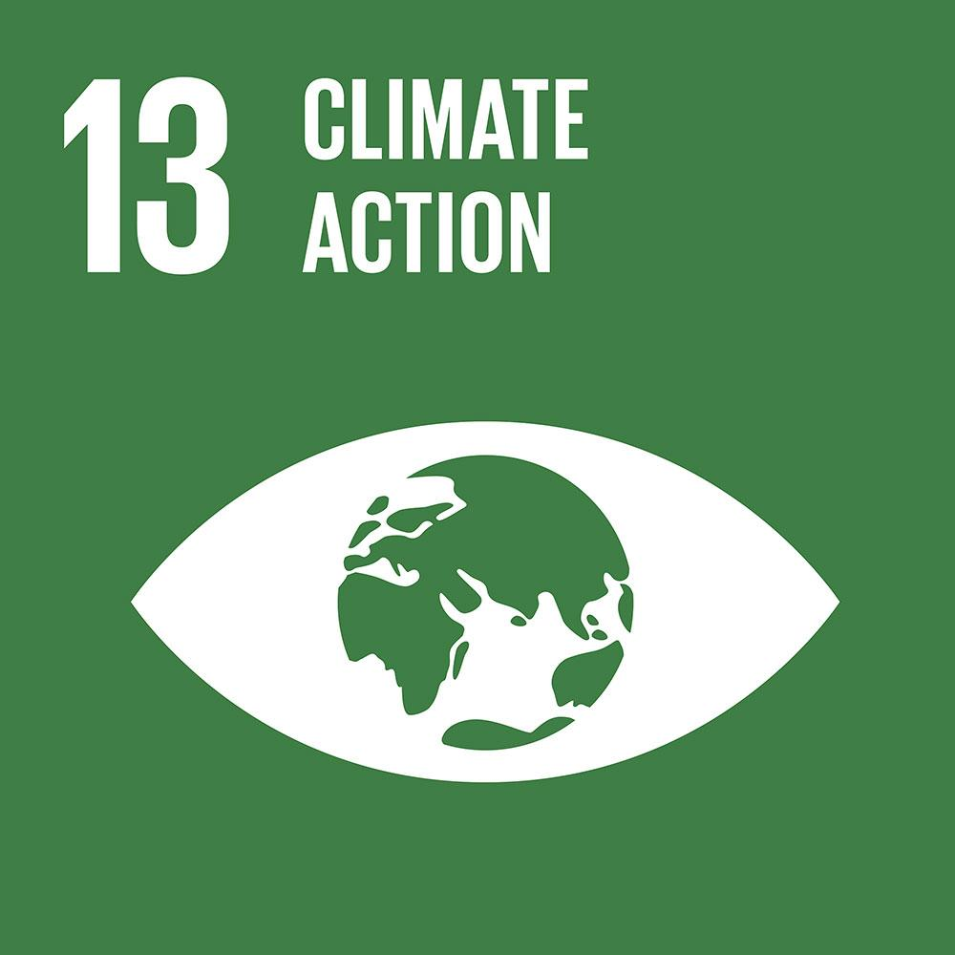
Goal 13: Take urgent action to combat climate change and its impacts
Notes:
Climate change is now affecting every country on every continent. It is disrupting national economies and affecting lives, costing people, communities and countries dearly today and even more tomorrow.
People are experiencing the significant impacts of climate change, which include changing weather patterns, rising sea level, and more extreme weather events. The greenhouse gas emissions from human activities are driving climate change and continue to rise. They are now at their highest levels in history. Without action, the world’s average surface temperature is projected to rise over the 21st century and is likely to surpass 3 degrees Celsius this century—with some areas of the world expected to warm even more. The poorest and most vulnerable people are being affected the most.
Affordable, scalable solutions are now available to enable countries to leapfrog to cleaner, more resilient economies. The pace of change is quickening as more people are turning to renewable energy and a range of other measures that will reduce emissions and increase adaptation efforts.
But climate change is a global challenge that does not respect national borders. Emissions anywhere affect people everywhere. It is an issue that requires solutions that need to be coordinated at the international level and it requires international cooperation to help developing countries move toward a low-carbon economy.
To address climate change, countries adopted a global agreement in Paris December 2015.

Slide 24
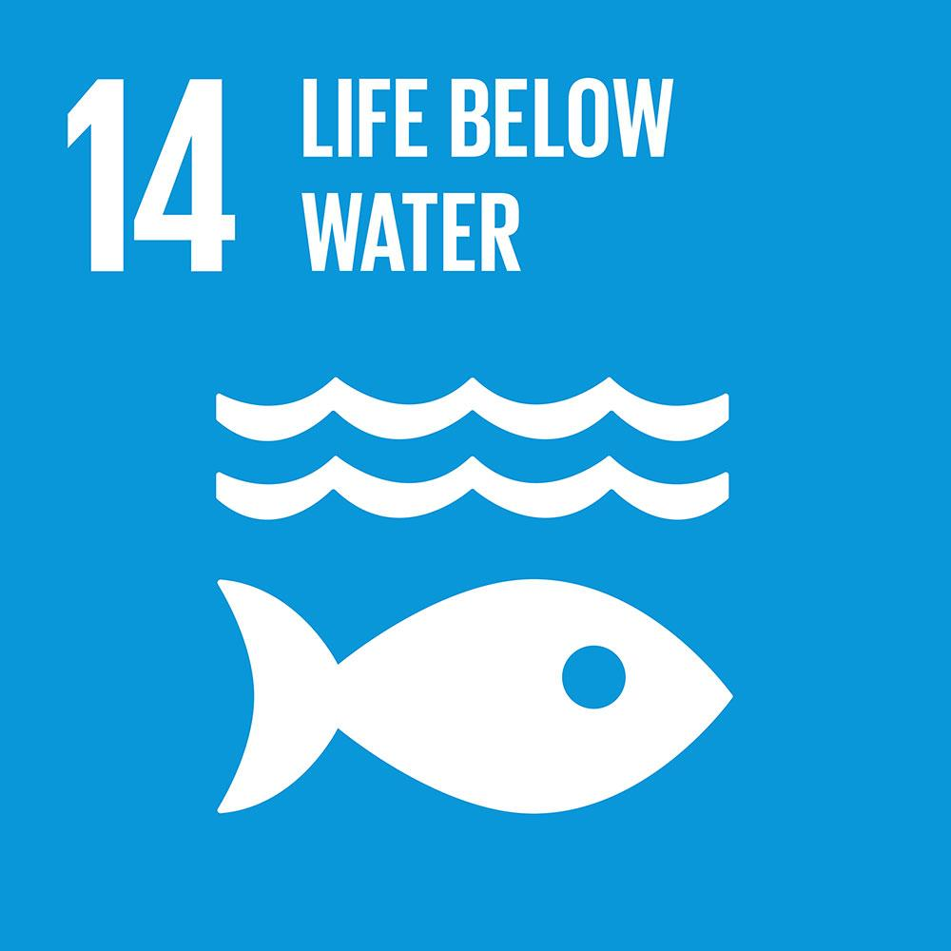
Goal 14: Conserve and sustainably use the oceans, seas and marine resources
Notes:
The world’s oceans – their temperature, chemistry, currents and life – drive global systems that make the Earth habitable for humankind.
Our rainwater, drinking water, weather, climate, coastlines, much of our food, and even the oxygen in the air we breathe, are all ultimately provided and regulated by the sea. Throughout history, oceans and seas have been vital conduits for trade and transportation.
Careful management of this essential global resource is a key feature of a sustainable future.

Slide 25
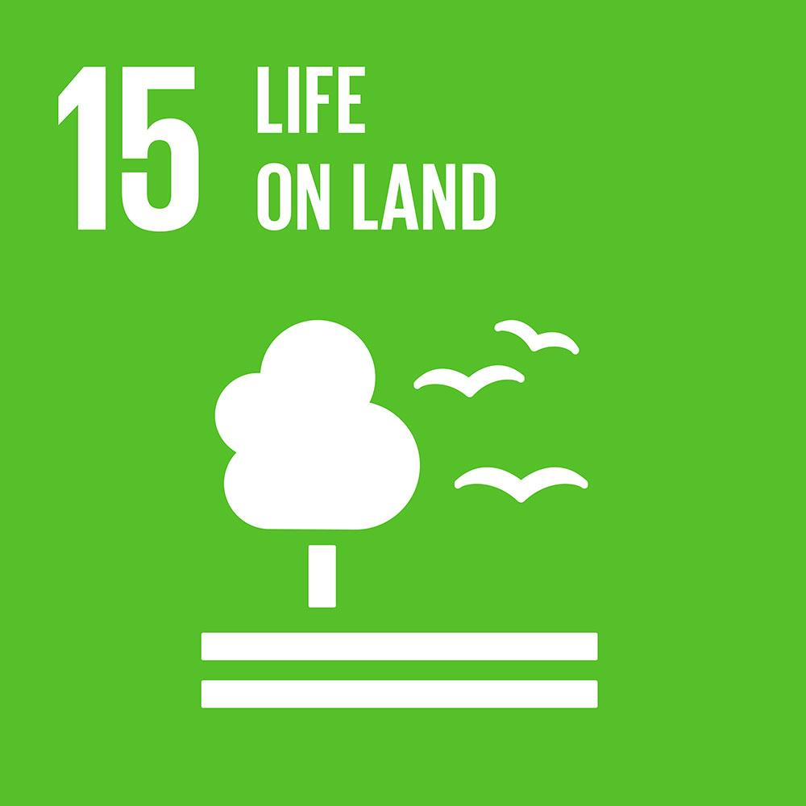
Goal 15: Sustainably manage forests, combat desertification, halt and reverse land degradation, halt biodiversity loss
Notes:
Forests cover 30 per cent of the Earth’s surface and in addition to providing food security and shelter, forests are key to combating climate change, protecting biodiversity and the homes of the indigenous population. Thirteen million hectares of forests are being lost every year while the persistent degradation of drylands has led to the desertification of 3.6 billion hectares.
Deforestation and desertification – caused by human activities and climate change – pose major challenges to sustainable development and have affected the lives and livelihoods of millions of people in the fight against poverty. Efforts are being made to manage forests and combat desertification.

Slide 26

Goal 16: Promote just, peaceful and inclusive societies
Notes:
Goal 16 of the Sustainable Development Goals is dedicated to the promotion of peaceful and inclusive societies for sustainable development, the provision of access to justice for all, and building effective, accountable institutions at all levels.

Slide 27

Goal 17: Revitalize the global partnership for sustainable development
Notes:
A successful sustainable development agenda requires partnerships between governments, the private sector and civil society. These inclusive partnerships built upon principles and values, a shared vision, and shared goals that place people and the planet at the centre, are needed at the global, regional, national and local level.
Urgent action is needed to mobilize, redirect and unlock the transformative power of trillions of dollars of private resources to deliver on sustainable development objectives. Long-term investments, including foreign direct investment, are needed in critical sectors, especially in developing countries. These include sustainable energy, infrastructure and transport, as well as information and communications technologies. The public sector will need to set a clear direction. Review and monitoring frameworks, regulations and incentive structures that enable such investments must be retooled to attract investments and reinforce sustainable development. National oversight mechanisms such as supreme audit institutions and oversight functions by legislatures should be strengthened.

Slide 28
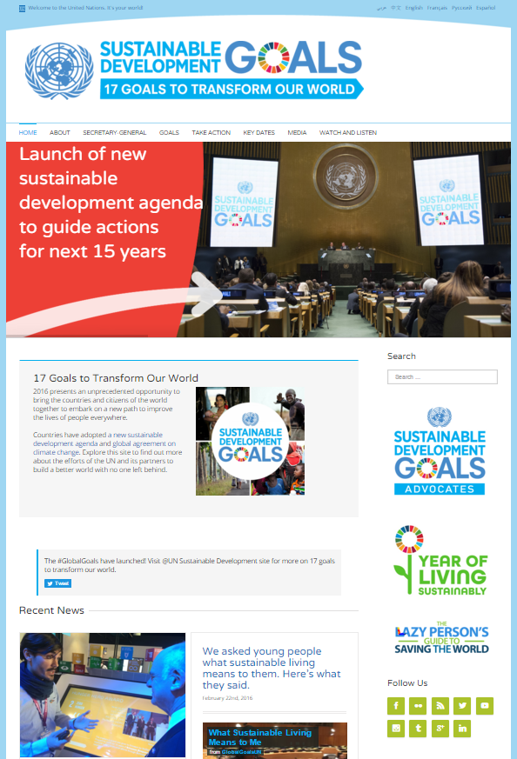



UN DPI Communications Campaign 2016
SDGs: 17 Goals to Transform Our World
Key Goals: Popularise SDGs, Spur Action and Leverage and Scale Up Partnerships
Comprehensive communications materials in all 6 official UN languages, including the SDG icons, press releases
Website:www.un.org/sustainabledevelopment
Social media
@GlobalGoalsUN
#GlobalGoals
Notes:
2016 is pivotal as countries begin to mobilize efforts to achieve the Sustainable Development Goals. The promotion of the 2030 Agenda for Sustainable Development is DPI’s primary communications priority for 2016.
A new UN communications campaign “17 Goals to Transform Our World” was launched at the beginning of 2016 to continue mainstreaming SDGs and highlighting their importance, as well as stimulating action by all stakeholders—governments, the private sector and civil society—to successfully implement the goals.
This year-long campaign focuses on strengthening existing partnerships and forming new ones across the UN system and externally to help promote key events around the SDGs.
The campaign website “un.org/sustainabledevelopment” and social media sites–facebook, twitter and vimeo–are updated regularly with news on SDGs issues and new online contents.
Comprehensive communications materials in all 6 official UN languages, including the SDG icons, fact sheets, backgrounders and press releases, were issued on January 1, when the SDGs were officially launched. These materials were shared with UNICs and the UN System. DPI will be regularly updating these throughout the year.

Slide 29
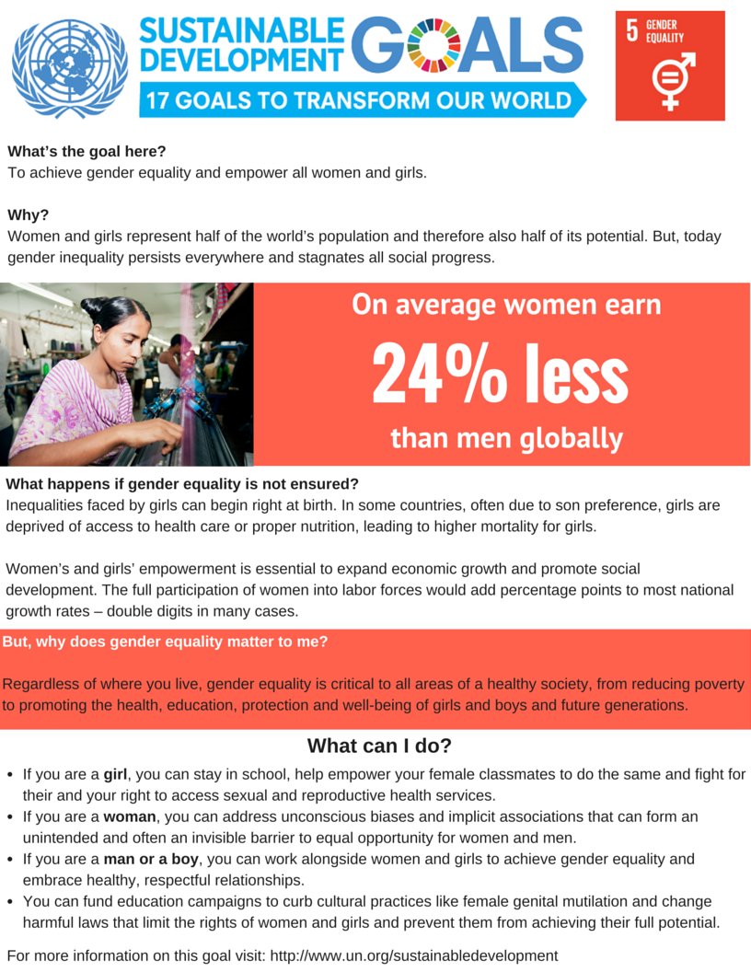


www.un.org/sustainabledevelopment/takeaction
Notes:
As part of the umbrella campaign, two new initiatives: “Year of Living Sustainably” and “SDGs–Why they matter to me,” have also being launched that will connect the SDGs with people’s lives, establishing local ownership of goals that are global in nature.
Year of Living Sustainably overview: The Global Goals are important, world-changing objectives that will require cooperation among governments, international organizations and world leaders. It seems impossible that the average person can make an impact.
Should you just give up?
No! Change starts with you. Seriously.
Every human on earth—even the most indifferent, laziest person among us—is part of the solution. Fortunately, there are some easy things we can adopt into our routines that, if we all do it, will make a big difference.
We’ve made it easy for you and compiled just a few of the many things you can do to make an impact.

Slide 30
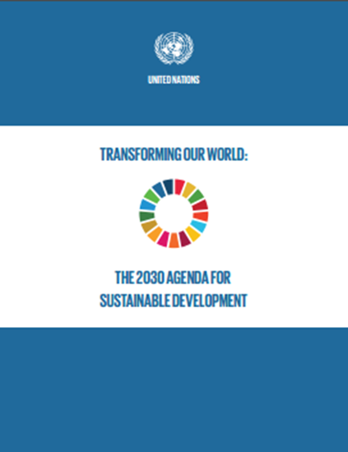
Resources
Transforming Our World: The 2030 Agenda for Sustainable Development
Available in all UN official languages
Notes:
UN websites on sustainable development in all official languages:
www.un.org/sustainabledevelopment
Link to Publication:
Transforming Our World: The 2030 Agenda for Sustainable Development https://sustainabledevelopment.un.org/content/documents/21252030%20Agenda%20for%20Sustainable%20Development%20web.pdf
Link to 2030 Agenda for Sustainable Development:
Arabic http://www.un.org/ga/search/view_doc.asp?symbol=A/69/L.85&Lang=A
Chinese http://www.un.org/ga/search/view_doc.asp?symbol=A/69/L.85&Lang=C
English http://www.un.org/ga/search/view_doc.asp?symbol=A/69/L.85&Lang=E
French http://www.un.org/ga/search/view_doc.asp?symbol=A/69/L.85&Lang=F
Russian http://www.un.org/ga/search/view_doc.asp?symbol=A/69/L.85&Lang=R
Spanish http://www.un.org/ga/search/view_doc.asp?symbol=A/69/L.85&Lang=S

Slide 31
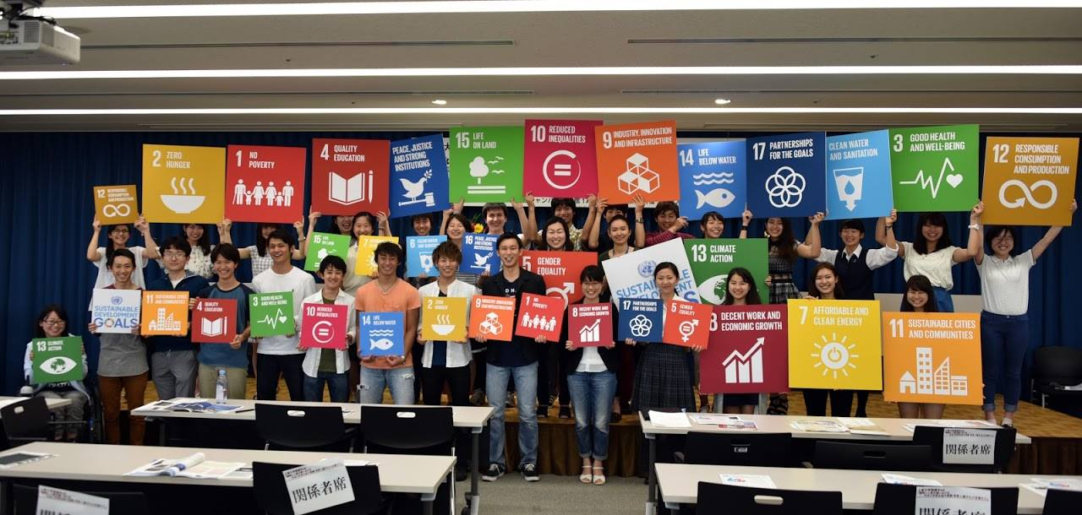
Let´s promote SDGs in Japan
The SDGs photo contest opening commemoration （Sophia Univ. 10/06/2016）

Slide 32
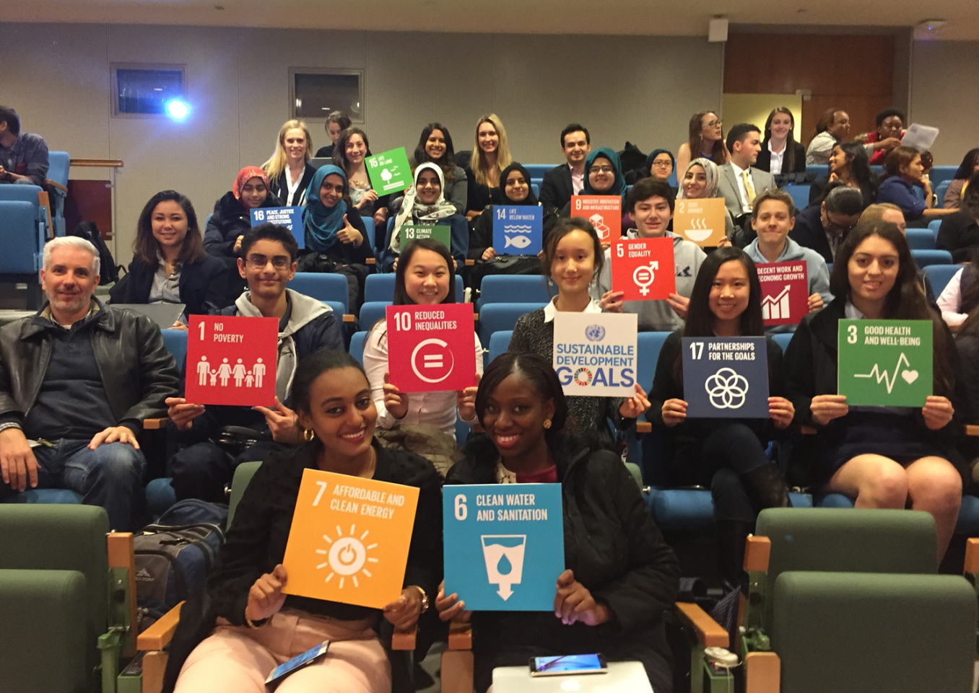
Generic slide

