Slide 1


SDG 14 Oceans
Challenges & Opportunities
Andrew Hudson
Head, Water & Ocean Governance Programme
Global Environmental Finance Unit
Sustainable Development Cluster
Bureau for Policy & Programme Support
United Nations Development Programme
Oceans WebEx Overview DPI-UNICs
6 March 2017

Slide 2
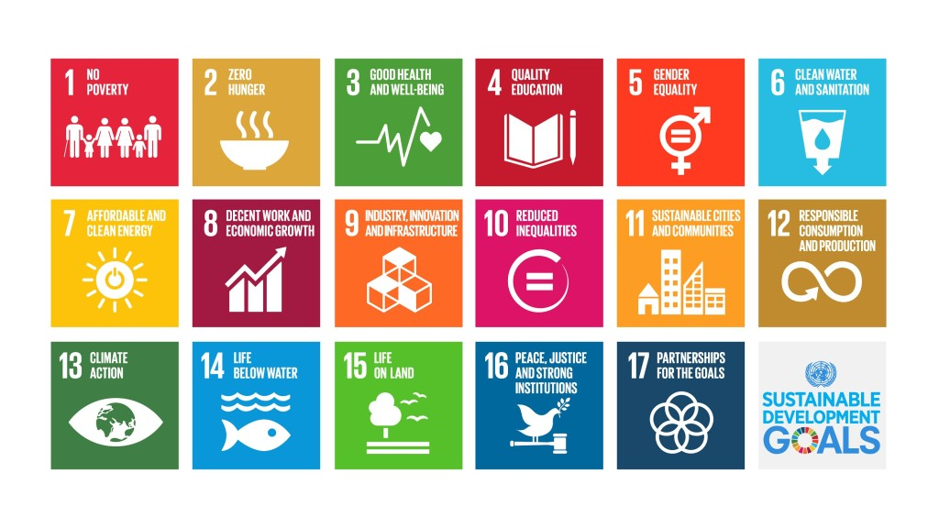
SDG14: Conserve and sustainably use the oceans, seas and marine resources for sustainable development
17 Sustainable Development Goals

Slide 3
6.3 By 2030 halve proportion untreated wastewater
Where we are now | The SDG Challenge
Present, about 2.52 billion people (35%) have wastewater treated | Halving (e.g. moving to 67.5%) requires treating wastewater for about 2.32 billion additional people Need to add 154 million/year

Slide 4
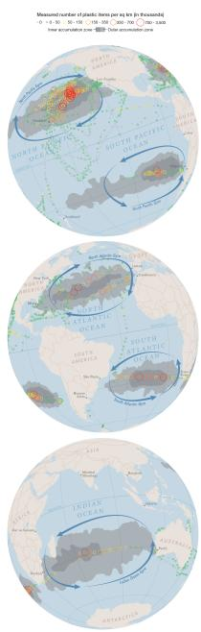
14.1 By 2025, prevent & significantly reduce marine pollution esp marine debris & nutrients

Slide 5
14.1 By 2025, prevent & significantly reduce marine pollution esp marine debris & nutrients
Where we are now | The SDG Challenge
Nitrogen loads to oceans roughly tripled from pre-industrial times (fertilizer, manure, wastewater) Geometric increase in hypoxic zones Global economic damage nitrogen pollution $200–800 billion/year | Transformational policy changes and economic incentives in nitrogen management across multiple sectors needed at all levels of governance (UNEP et al., 2012)
300 million mt/year plastics Global plastics recycling rate ~24% 8-20 million mt/year plastics entering oceans and growing rapidly (x10 by 2025) esp in developing regions Damage to marine ecosystems $13 billion/year (UNEP, 2014) | There are numerous proven strategies, policies etc. that can deliver large reductions in plastics pollution, need widespread adoption and scaling up

Slide 6
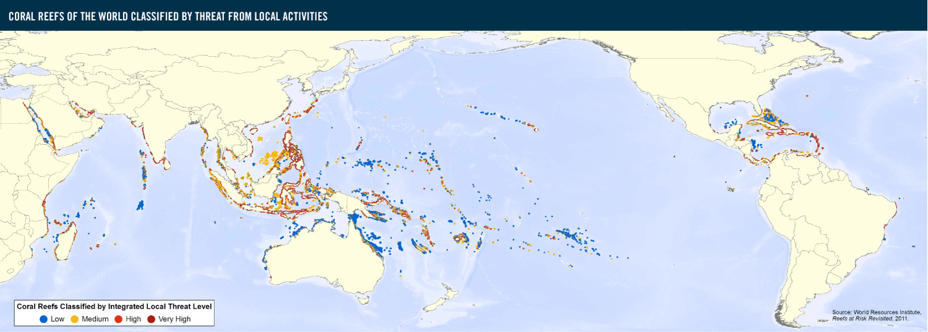
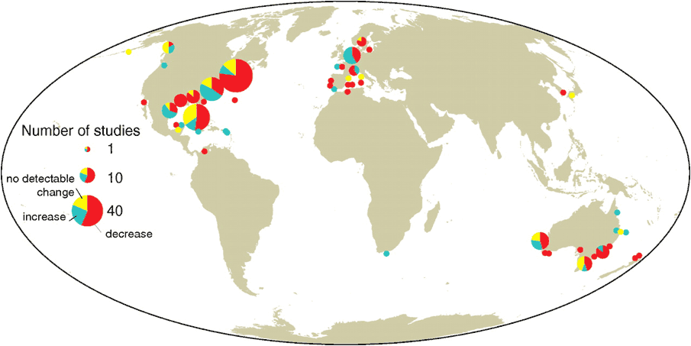
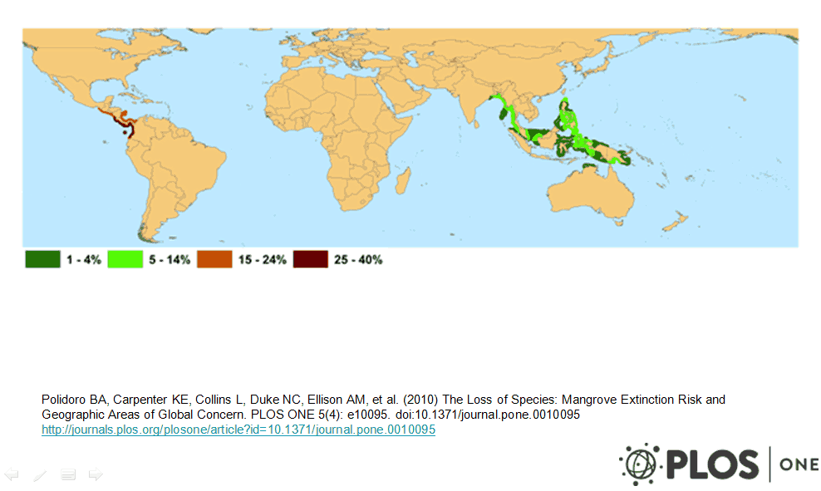
14.2 By 2020, sustainably manage and protect marine and coastal ecosystems to avoid significant adverse impacts
Seagrass Loss Mangrove Loss

Slide 7
14.2 By 2020, sustainably manage and protect marine and coastal ecosystems
Where we are now | The SDG Challenge
An estimated 20% of global mangroves have been lost since 1980 19% of coral reefs have disappeared 29% of sea grass habitat has vanished since 1879 | Need to properly value ecosystem services such habitats provide including nurseries for fisheries, protecting coasts from storm surges, tourism, nutrient and carbon sinks Carbon finance potential for mangrove & seagrass protection and restoration (‘blue carbon’) New threats from climate change (warming, sea level rise, deoxygenation, ocean acidification)

Slide 8
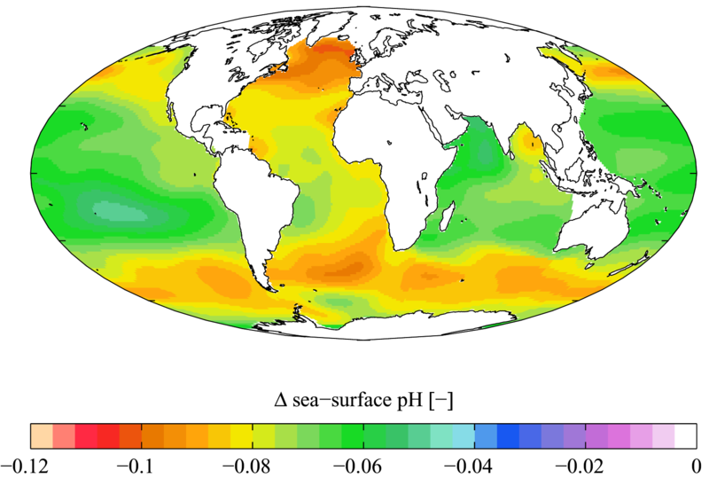
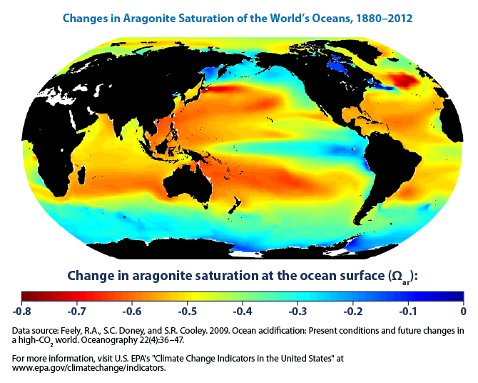
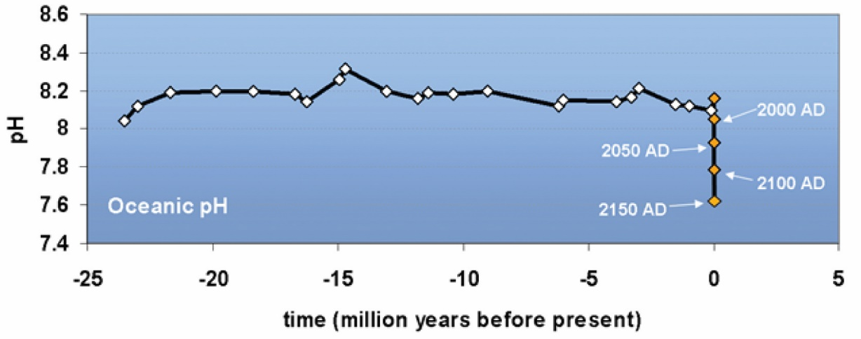
14.3 Minimize and address ocean acidification

Slide 9
14.3 Minimize and address ocean acidification (OA)
Where we are now | The SDG Challenge
30% anthropogenic CO₂ dissolves into surface oceans Ocean pH already decreased about 0.1 pH unit Increased acidity prevents CaCO₃ organisms from producing shells & skeletons; reverberates thru ecosystem Several ecosystems, especially polar regions, already showing impacts | BAU GHG pathway ocean pH decreases another 0.3-0.4 units, virtually certain major deterioration ocean ecosystems BAU economic costs $1.2 trillion/year by 2100 (Brander, 2011) Global action on climate change mitigation (Paris agreement) is directly correlated with reversing ocean acidification

Slide 10
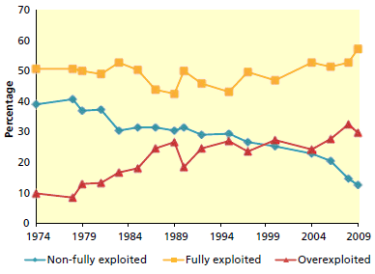
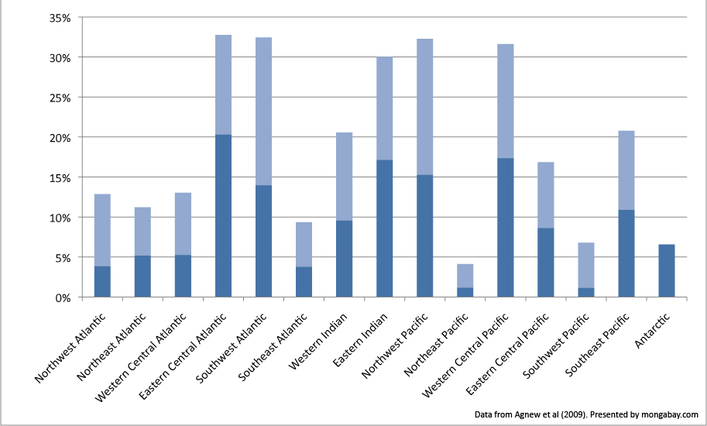
14.4 By 2020 End IUU and Overfishing
Estimated illegal fish catch as
percentage of total catch
(low & high estimates)

Slide 11
14.4 By 2020 end IUU & overfishing
Where we are now | The SDG Challenge
About 30% fish stocks overexploited IUU affects about 20% global fish yields worth about $23 billion/year Strong relationship between IUU (illegal, unregulated, unreported) & over-fishing and weak fisheries governance (Agnew et al. 2009) | Average 6% per year of stocks moved towards sustainable use by 2020 Eliminate average 4% IUU per year to 2020

Slide 12
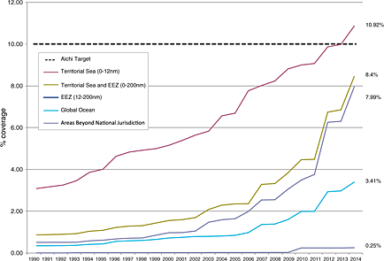
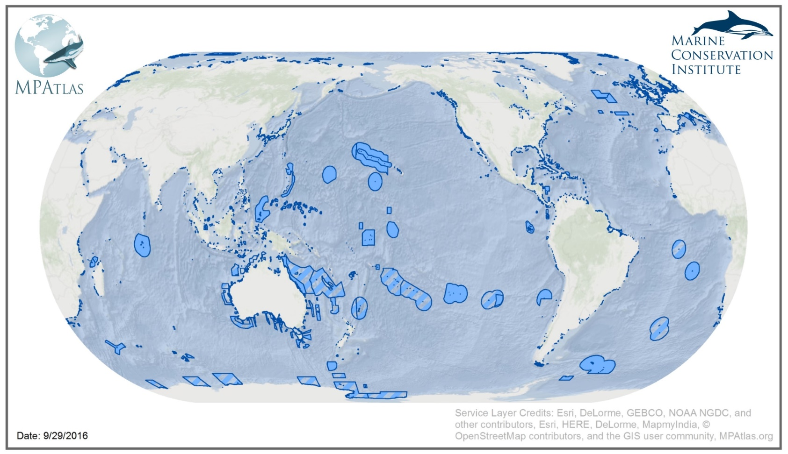
14.5 By 2020 Conserve at least 10% coastal & marine areas

Slide 13
14.5 By 2020 conserve at least
10% coastal & marine areas
Where we are now | The SDG Challenge
8.4% EEZs under MPAs, Aichi 10% EEZs projected to be achieved in 2016 (CBD) SDG calls for 10% of entire OCEAN under MPA, presently at ~4% World added ~0.26% ocean per year 2004-14 Very small proportion of high seas protected (0.25%); key negotiations on UNCLOS implementing agreement on ABNJ have begun | 10% by 2020 requires 1.3% more ocean under MPA per year (4.7 million sq km/yr), 5x rate from 2004-14 Progress/concluding on ABNJ agreement may take time => focus of near-term action in EEZs Many scientists concur that 10% isn’t sufficient for true protection and sustainability, more like 30% desired.

Slide 14
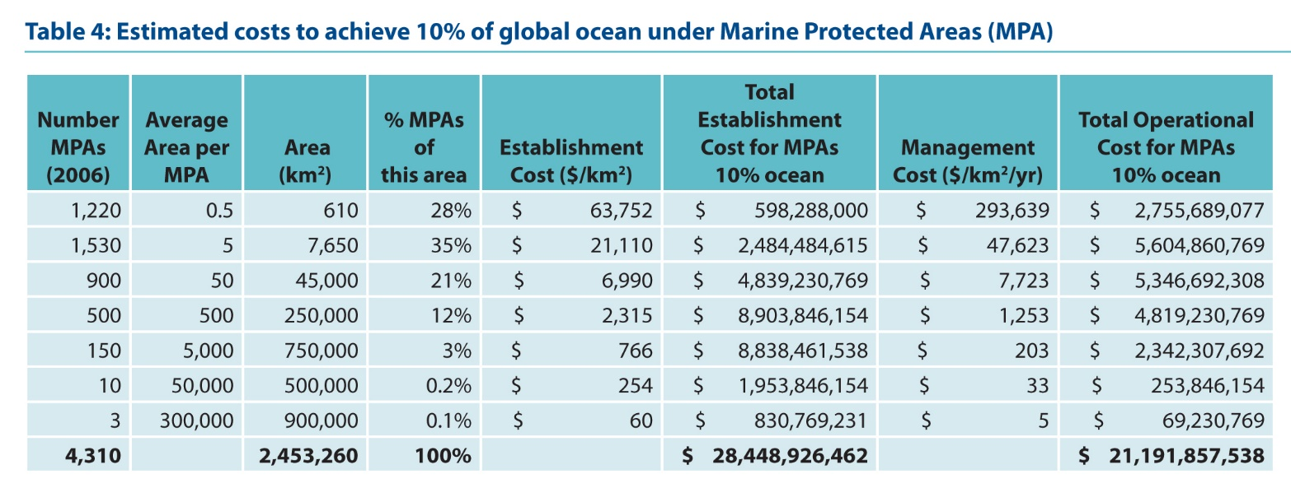
14.5 By 2020 Conserve at least 10% coastal and marine areas

Slide 15
14.6 By 2020 prohibit destructive fisheries subsidies

Slide 16
14.6 Prohibit subsidies that contribute to overcapacity & overfishing
Where we are now | The SDG Challenge
60% global fisheries subsidies = $16 billion/year, support unsustainable practices Ship fuels, boat construction and renovation, tax breaks, access rights, and other transfers 68% developed (39), 32% developing (107) | WTO negotiations on destructive fisheries subsidies underway since 2000 Steering negative subsidies towards sustainable fishing (and aquaculture) could provide massive infusion of financial resources

Slide 17
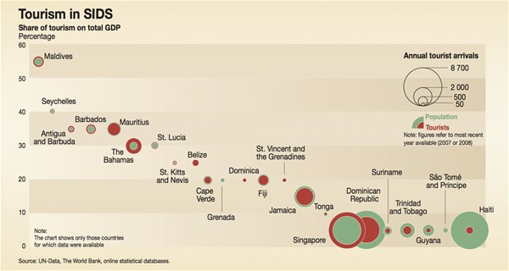
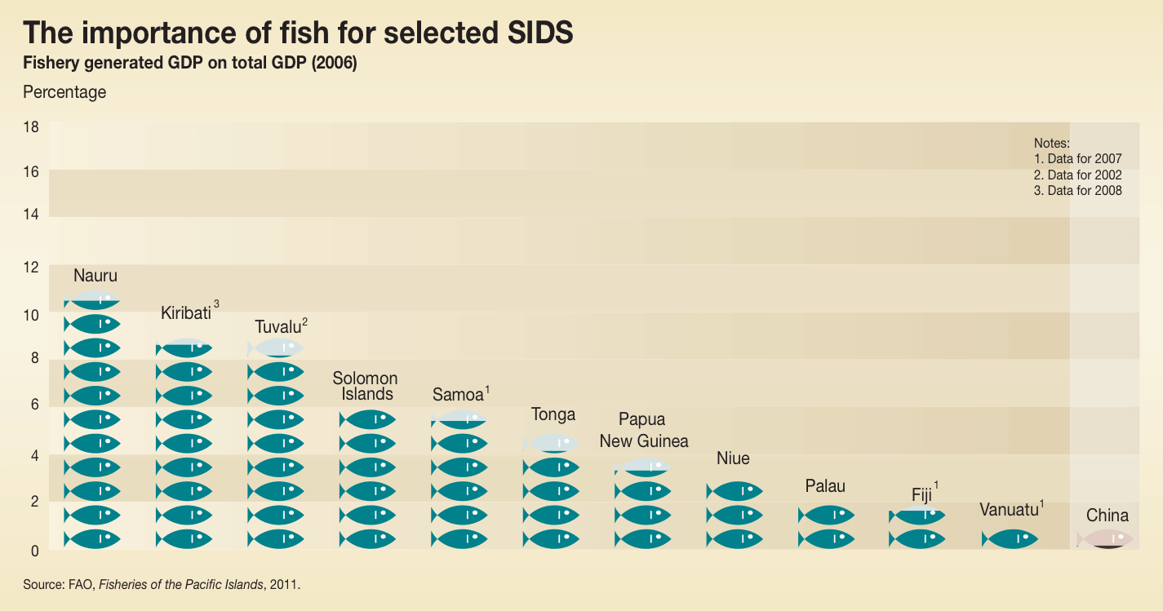
14.7 By 2030, increase economic benefits to SIDS & LDCs from marine resources

Slide 18
14.7 By 2030, increase economic benefits to SIDS & LDCs from marine resources
Where we are now | The SDG Challenge
SIDS exports of fish products US$1.75 billion (2012), ~7% of Exports and 1.7% GDP; increased about 50% 2006-12 SIDS tourism exports $24 billion, 50% of their services exports. Hotel related FDI to SIDS increased to ~$0.5 billion in 2012 BUT… Fisheries in SIDS subject to as much as $872 m. in harmful subsidies (Sumaila) ~60% of SIDS stocks are overfished leading to realization of only 48% of potential economic benefits in their EEZs. | SIDS need assistance in developing and implementing their ‘blue economy’ strategies to optimize their roles as ‘Large Ocean States’ and grow economies

Slide 19
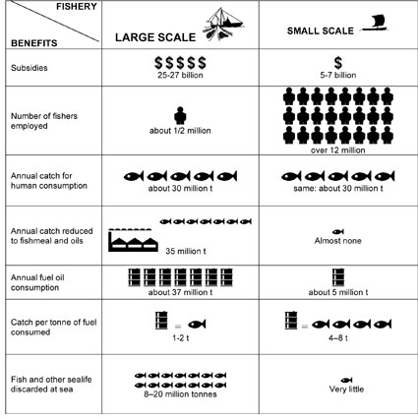
14.b Provide access for Small Scale Fisheries
(SSF) to marine resources & markets

Slide 20
14.b Provide access for Small Scale Fisheries (SSF) to marine resources & markets
Where we are now | The SDG Challenge
SSF supply almost 1/2 world’s seafood supply, employ ~ 90% of those involved in the sector, contributing to far more livelihoods on a per volume seafood basis. SSF use 1/7 energy of large scale to catch ~ same volume fish. Most SSF providing raw products to domestic and int'l markets so gaining little in value added. Small scale fisheries disadvantaged by much greater subsidies to large scale, lack of co-management arrangements, lack of access to markets even domestically, lack of pricing power. | SSF have significant capacity building and financing needs. Governments need legislation to incentivize wholesalers and processors to source fish from SSF. Fish pricing needs to be more transparent and accessible. Remove unfair subsidies.

Slide 21
SDGs 14 (and 6!) are extremely ambitious and in several cases require transformational changes in ocean management and governance
“….more, better, sooner”

